Slide 1
Weekly Report
Prof. Huang && Shuo Zhang

Slide 2
Paper List
Experimental Study of Multivariate Time Series Forecasting Models, CIKM, 2019
Correlated Time Series Forecasting using Multi-Task Deep Neural Networks, CIKM, 2018
Time-Series Aware Precision and Recall for Anomaly Detection, CIKM, 2019

Slide 3
Experimental Study of Multivariate Time Series Forecasting Models
However, one question still remains unclear: how these models perform on a certain forecasting task, and there is lack of comprehensive performance comparison of these models on different tasks.
To this end, in this paper, we conduct a systematic evaluation of eight representative forecasting models over eight multivariate time series datasets

Slide 4
Experimental Study of Multivariate Time Series Forecasting Models
1) When the datasets exhibit strong periodic patterns, deep learning models perform best. Otherwise on the datasets in a non-periodic manner, the statistical models such as ARIMA perform best.
2) For the long term prediction involving a high horizon value, the direct prediction strategy could lead to lower errors than the recursive one, but at the cost of higher training time.
3) For the multivariate time series explicitly involving graphic inter-dependencies among the multivariates, the Graph Convolution Network can incorporate the graphic inter-dependencies into their forecasting models for smaller prediction errors

Slide 5
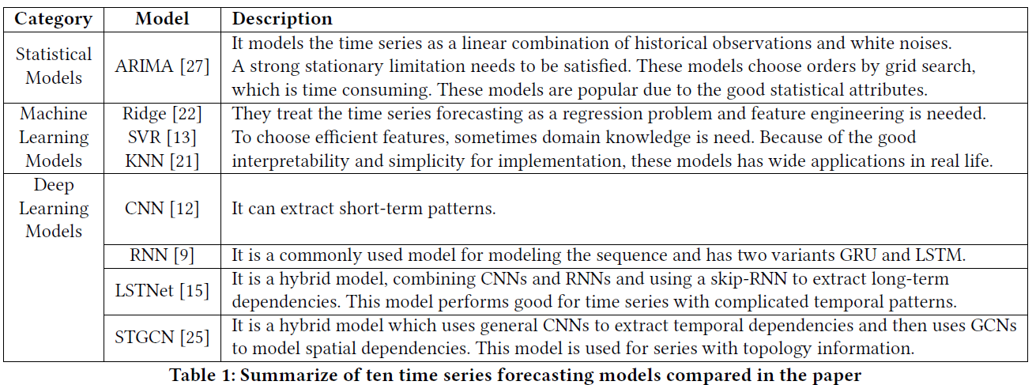
Experimental Study of Multivariate Time Series Forecasting Models

Slide 6
Experimental Study of Multivariate Time Series Forecasting Models
Both CNN and RNN can only extract latent representations from Euclidean data such as images, text, and videos. While not all data are generated from non-Euclidean domains: some data with graph structure cannot be processed using CNNs or RNNs directly.
Recently, researchers have increasing interest in extending deep learning approaches for graph data and many models are proposed. The Graphical Convolutional Network (GCN) model [6, 14] is one of the representative works

Slide 7
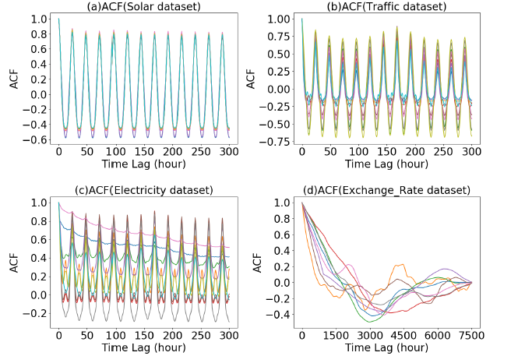
Experimental Study of Multivariate Time Series Forecasting Models

Slide 8
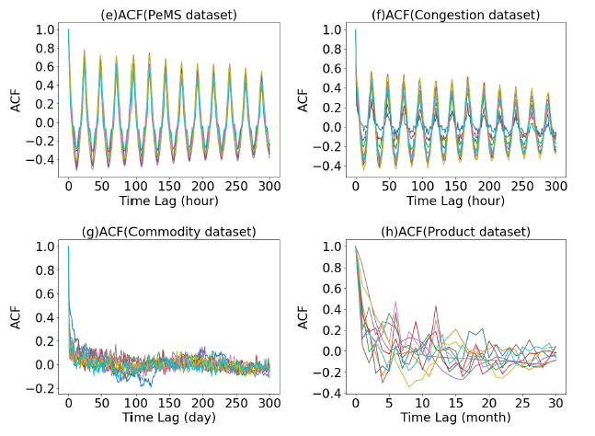
Experimental Study of Multivariate Time Series Forecasting Models

Slide 9
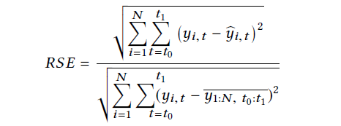
Experimental Study of Multivariate Time Series Forecasting Models
Compared to RMSE, RSE is more readable because it can ignore the influence of data scale and it is able to recognize outlier prediction results.

Slide 10
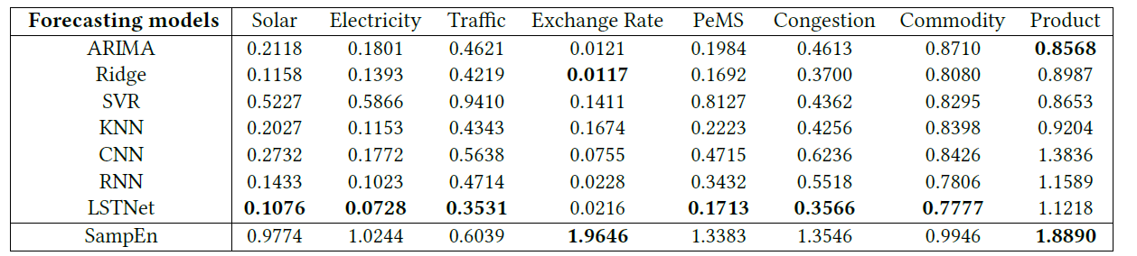
Experimental Study of Multivariate Time Series Forecasting Models

Slide 11
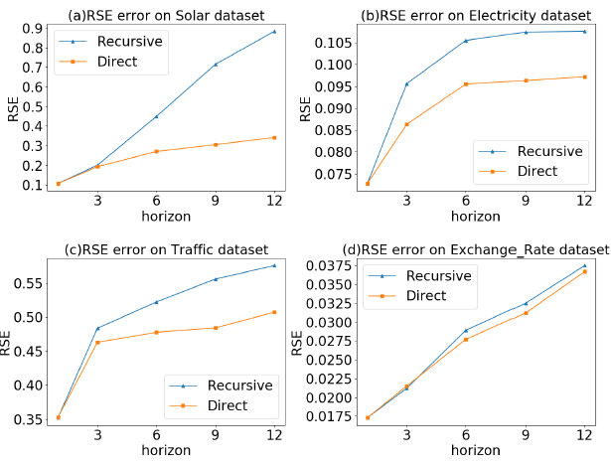
Experimental Study of Multivariate Time Series Forecasting Models

Slide 12
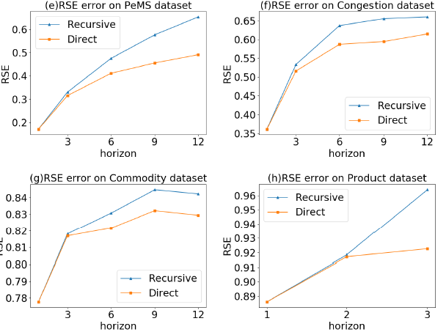
Experimental Study of Multivariate Time Series Forecasting Models

Slide 13
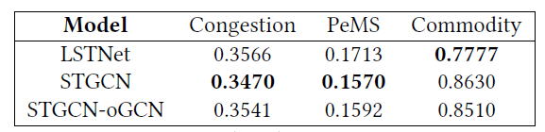
Experimental Study of Multivariate Time Series Forecasting Models

Slide 14
Correlated Time Series Forecasting using Multi-Task DeepNeural Networks
Cyber-physical systems often consist of entities that interact with each other over time. Meanwhile, as part of the continued digitization of industrial processes, various sensor technologies are deployed that enable us to record time-varying attributes (a.k.a., time series) of such entities, thus producing correlated time series.
To enable accurate forecasting on such correlated time series, this paper proposes two models that combine convolutional neural networks (CNNs) and recurrent neural networks (RNNs).

Slide 15
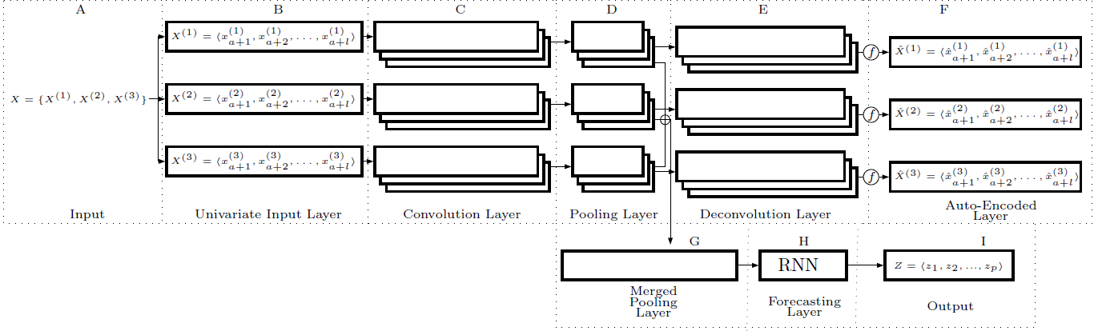
Correlated Time Series Forecasting using Multi-Task DeepNeural Networks

Slide 16


Correlated Time Series Forecasting using Multi-Task DeepNeural Networks
The objective function of CRNN is:
The objective function of AE is:

Slide 17
Time-Series Aware Precision and Recall for Anomaly Detection
In time-series data, an anomaly corresponds to a series of instances. The conventional metrics, however, overlook this characteristic, so they suffer from a problem of giving a high score to the method that only detects a long anomaly.
To overcome the problem, our metrics consider the variety of the detected anomalies to be more important through two scoring strategies, detection scoring (i.e., how many anomalies are detected) and portion scoring (i.e., how precisely each anomaly is detected).

Slide 18
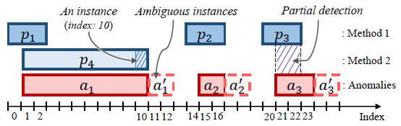
Time-Series Aware Precision and Recall for Anomaly Detection

Slide 19
Plan
Improvement on Dual-Window R-C
Researching on Data Imputation or Prediction of time series
Remediation on knowledge of statistics

Slide 20
Thanks
@MICC

